Slide 1
Public Relations and the ethical triangle
Lael Wageneck
CAPIO 2017
Notes:
Slide 1:
Hello. I’m Lael Wageneck and I am the Public Engagement Specialist for the Santa Barbara County Public Works Department. A few years ago I took a very enlightening class on ethics. What I learned in the class is that ethics goes way beyond the law and into questions on how to live a good life, be yourself, and make good decisions. I am also one of those people who ask “why” a lot. Why do some people make some decisions and others make other decisions? The study of ethics appeals to me because it has helped me to answer those questions and learn what people value. This is a difficult topic to discuss in under an hour, but I will hopefully leave you with a better understanding of ethics along with a list of resources you can go use to further explore the topic.

Slide 2
The ethical triangle
Framing the question based on virtue, principle, and consequence.
Virtue
Define the problem
  right vs. right
Consider responses
Test response against the ethical triangle
Consider other responses
Choose response
Implement response
Principle
Consequence
Notes:
Slide 2:
This slide shows you where we are going to be in about a half hour. This may not make any sense now but this will be your all encompassing ethics reference sheet by the end of the session. I did not come up with the idea of the ethical triangle but I learned about it through an essay written by James Svara who is a professor in political science at the UNC school of government.
(cite)

Slide 3
What is ethics?
Notes:
Slide 3:
I won’t put anyone on the spot, but go ahead and silently ask yourself what ethics is. The extent of ethics training for many organizations tends to focus on legal issues related to harassment and conflict of interest. But ethics is more than asking what is legal and what is illegal.

Slide 4
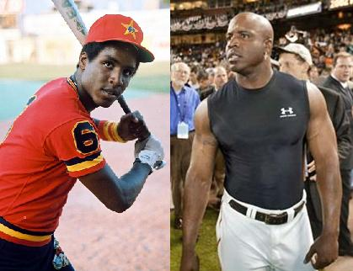
What is ethics and what are morals?
Ethics:
  The discipline dealing with what is good and bad and with moral duty and obligation.
Morals:
  Individual or group rules or values
Notes:
Slide 4a:
The words ethics and morals get switched around. Think of ethics as the discipline that asks what a good action is. Morals are a set of actions that a person or group define as good. For example, after discussing the ethics of cheating with my teammates, I decided it was against my morals to take performance enhancing drugs.
The Greeks used the word ethos to define the character traits that if you applied them every day would lead to a good life. There are actually two ways to spell ethos in Greek. Spelled with an eta, ethos means a reliable and persistent personal quality. Spelled with an epsilon it means a horse stable. The implied meaning is that in the same way that a horse returns to the stable, a good person returns to this base of good character traits. For the Greeks, being an ethical person means living a life that deliberately applies these good character traits and that all of this makes life worth living.
Trivium – Page 298

Slide 5
Why is ethics important in communications?
Social Harmony
Trust
Professional Reputation
Organizational Reputation
Leadership
Self-Confidence
Notes:
Slide 5:
Why is any of this important when it comes to our jobs as communicators? Most every profession has a moral purpose. Medicine has health. Law has justice. Public relations has social harmony. Through communications we promote mutual understanding which will hopefully help people to work together.
Trust: We can do our jobs well when our colleagues or the public trust us. People can rely on us and expect us to do be honest about what’s going on in government.
Professional reputation: As professionals we are expected to have standards. When we communicate our values and live by them it supports our profession and other public information professionals.
Organizational reputation: The same goes with the clients we represent. When we communicate and live by our organizational values it helps people trust the organizations we work for.
Good leadership: You cannot be consistent or focused without defining what a good result is versus a bad result.
Self-Confidence: Not every action will have an outcome that we are happy with but if you apply a system of ethics to your decision making you can at least feel confident that you personally made the right decision.
Seib and Fitzpatrick – Page 1

Slide 6
Approaches to ethics
Virtue
Law
Consequence
Notes:
Slide 6:
There are many approaches to ethics, but since we will be discussing the “ethical triangle”, we will focus on virtue, law, and consequence.

Slide 7
Ethical dilemmas: good vs. good
Ethical dilemmas arise from competing values
  Following the law versus protecting a life
  Obeying a religious figure versus following the law
  Obeying religious law versus national law
  Giving money to an individual versus an organization
  Serving the majority versus protecting the minority
Notes:
Slide 7:
How do we determine what is the right action to take? Follow the law? Ask yourself what someone you respect would do in the situation? Coin flip? Ethical dilemmas occur when you have to decide between doing two positive actions, or sometimes, the best option between two negative actions . It’s not a dilemma if you are deciding between the right thing versus doing the wrong thing. For example – following the law versus protecting a life. Doing what a religious leader tells you to do versus doing what the law tells you to do.
Richter and Burke Page 4

Slide 8
Three approaches
Virtue – character traits
Principle – rules/the law
Consequence – best result for the most people
Balance – The Ethical Triangle
Notes:
Slide 8:
We are going to look at four different ways, plus a bonus way, of determining what is the “right thing to do.” These four different ways are virtue - applying classically “good” character traits, principle - following the law, consequence - which includes determining the best result for the most amount of people, and a balance of these three which is the “ethical triangle.” We will also look at the negatives of applying each one of these approaches.

Slide 9
virtue
Good traits
Notes:
Slide 9:
We will start off with virtue.

Slide 10
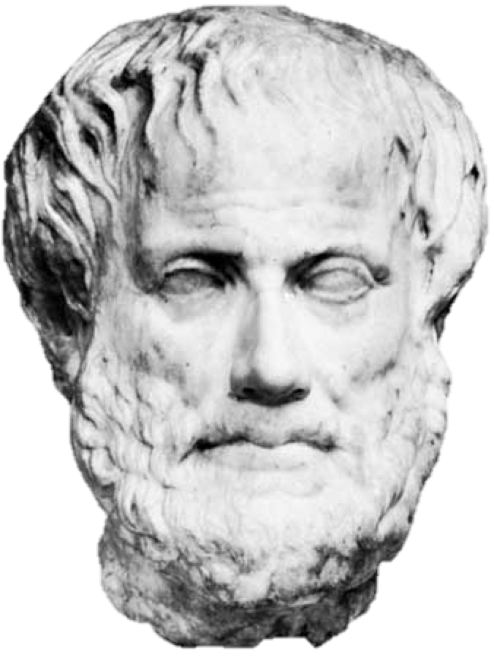
Virtue – personal traits
Aristotle
  Intellectual values:
    Wisdom and understanding.
    Gained through knowledge.
  Moral values:
    Which character traits should we purge and which are integral to a good life?
    Gained through practice.
Notes:
Slide 10:
When we talk about virtue we talk about these traits that make a good person. In his writings on ethics, Aristotle divided values between intellectual values and moral values. Aristotle believed that humans don’t become human by instinct but in a community through the development of language, and through rational deliberation, judgment, and responsible action. There are intellectual values like wisdom and understanding and we gain these through knowledge and learning. Moral values on the other hand are gained through practice. While we can know that something like friendliness is a good trait, we don’t have those values unless we practice them by acting in a friendly way.
Trivium – 307
Aristotle, Ethics, revised edition, J.A.K. Thompson, trans., (London: Penguin Books, [384-
322 BC] 1976), 90.

Slide 11
Virtuous traits
Aristotle
  Courage, Temperance, Generosity, Magnanimity, Gentleness, Truthfulness, Wit, Friendliness
Ambrose – Cardinal Virtues
  Courage, Moderation, Wisdom, Justice
PRSA – Code of Values
  Advocacy, Honesty, Expertise, Independence, Loyalty, Fairness
Notes:
Slide 11a:
What are some of these virtuous traits? Aristotle listed Courage, Temperance, Generosity, Magnanimity, Gentleness, Truthfulness, Wit, Friendliness. You may have also heard of the Cardinal Virtues. These came from Ambrose who was not a Cardinal but the Bishop of Milan, and he didn’t actually come up with them, he just took them from Cicero and Plato. Cardinal comes from the latin word for a door hinge, cardo, and the values represent the hinge that opens the door to a good life.
Because this is a CAPIO conference, I also added the PRSA code of values which are Advocacy, Honesty, Expertise, Independence, Loyalty, Fairness.
(RETURN FROM SLIDE)
Looking back at the PRSA Code of Values there is another example of how values can be difficult to define. I would consider “expertise” an intellectual value but not a moral value. It is valuable to be an expert, but I can’t think of a dilemma where you would have to choose between becoming a better communicator and being honest or loyal.
Trivium – 315 and 316
https://apps.prsa.org/AboutPRSA/Ethics/CodeEnglish/#MemberStatement

Slide 12
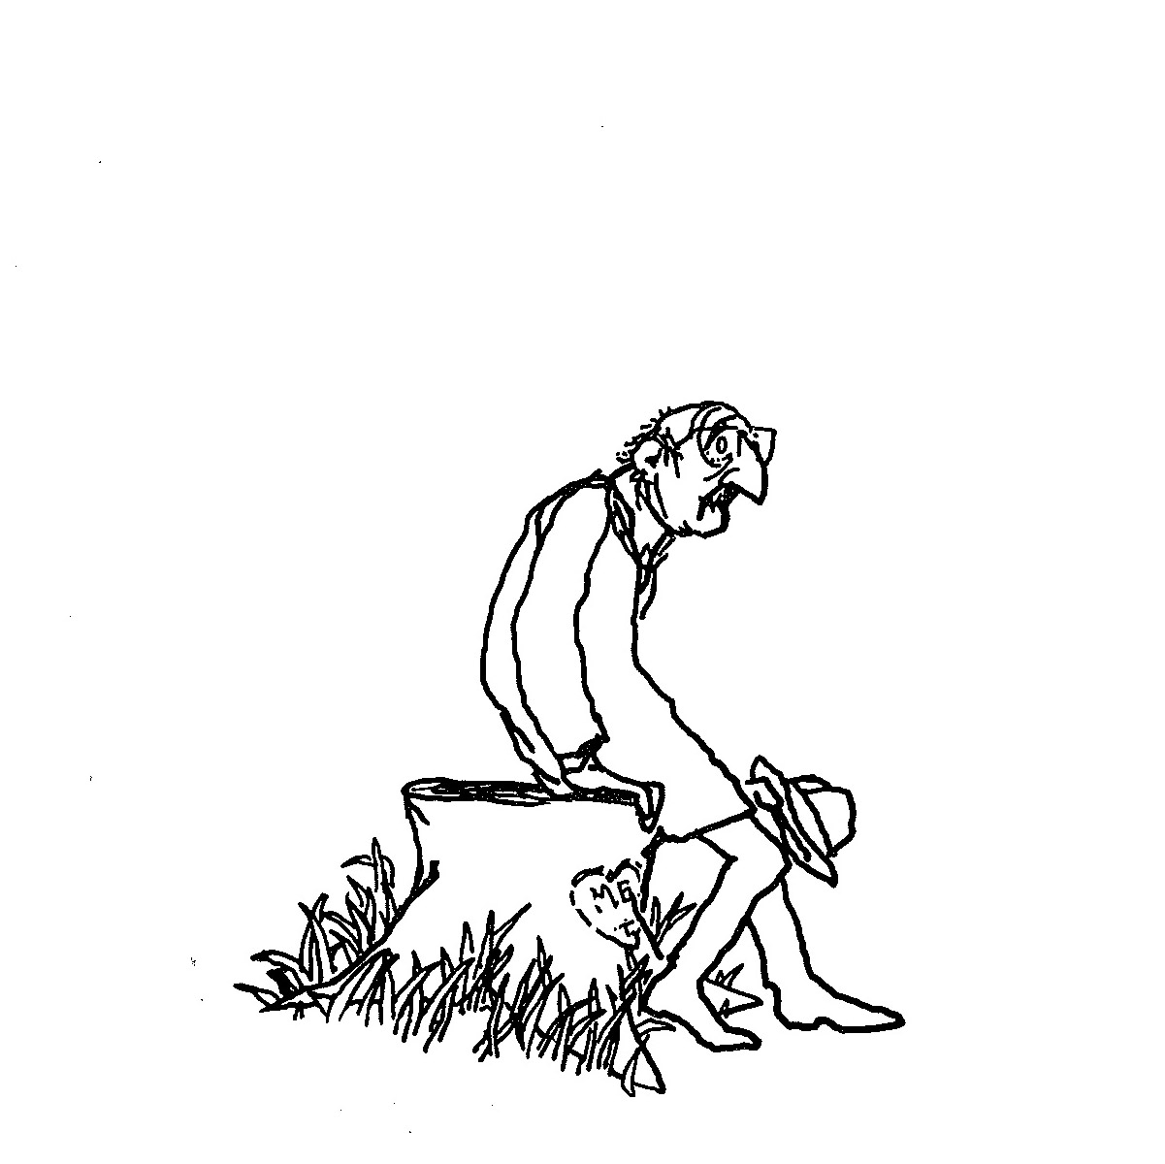
DIFFICULTIES OF VIRTUE
Difficult to define
  What does it mean to be generous?
Apply virtues judiciously
  Can you be too generous?
  Not generous enough?
Notes:
Slide 12:
The difficulty with relying on virtue is that these virtues can be difficult to define. What does it mean to be generous? Can you be too generous or not generous enough? How many of you have read The Giving Tree by Shel Silverstein? Boy meets Tree. Tree gives of self to Boy. Boy ends up as old man sitting on Tree stump. This is the drawing from the last page of the book. Your definition of generosity determines if you think this drawing is happy or depressing. Is this a good book because it is an example of altruistic love or is it depressing because the boy used that tree up and now there is very little of the tree left? (GO BACK TO PREVIOUS SLIDE)

Slide 13
principles
Good rules
Notes:
Slide 13:
Next we will discuss principles, or a rules based approach.

Slide 14
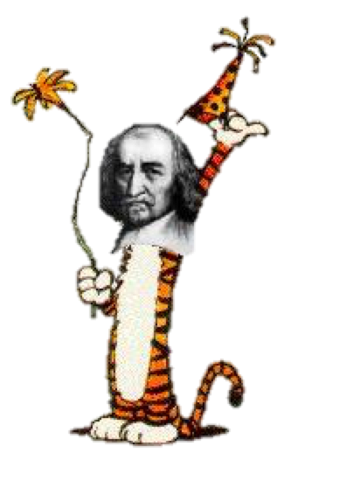
principles
Rule based approach
Kant:
  Supreme Categorical Imperative: Act only according to the maxim whereby you can at the same time will that it should become a universal law.
Hobbes:
  Natural law: “man is forbidden to do what is destructive of his life or takes away of preserving the same…”
Notes:
Slide 14:
When we talk about principles we are talking about a rule based approach. If you delve further into ethics you will hear this defined as “deontological ethics.” The idea is adhering to written laws based upon rational self-interest will benefit and create a peaceful society. If everyone trusts each other and follows the law then everything is going to be great. The primary example of principle based ethics is Emmanual Kant’s Supreme Categorical Imperative, which is also the name of my German techno band. “Act only according to the maxim whereby you can at the same time will that it should become a universal law.” Translated: “You should only do something if if it’s good every time you or someone else does it.” It’s kind of like the golden rule of do unto others as you would have them do unto you. We also have Thomas Hobbes quote from Leviathan stating that “man is forbidden to do what is destructive of his life or takes away of preserving the same.”
Thomas Hobbes, Leviathan Parts I and II, Herbert W. Schneider, ed., (Indianapolis: Bobbs-Merrill Company, [1651] 1958), 109.

Slide 15
Difficulties of principles
Life isn’t simple.
History is filled with bad laws we shouldn’t have followed (e.g. slavery).
Even the Golden Rule has exceptions
Shaw: “Do not do unto others as you would have them do unto you. They may have different tastes.”
Notes:
Slide 15:
The problem of the principles based approach is that life isn’t that simple. We aren’t computers. Life is too complicated to base on binary responses of always yes or always no. History is filled with bad laws that people should not have followed. Slavery for example. The Greeks believed in natural slavery, that some people were born to be slaves. Slave owners in the United States didn’t consider slaves to be equal or even human, which means the Golden Rule wouldn’t apply. It is also difficult to follow the golden rule when you consider things like cultural differences. The playwright George Bernard Shaw addressed this when he said “do not do unto others as you would have them do unto you. They may have different tastes.”
I was at a training recently where I heard about the “Platinum Rule” which is “treat others the way they want to be treated.” This is also difficult to treat others the way they want to be treated because I may have different tastes. I once asked my barber what was the oddest request for a haircut she had received. She said that a mother needed her child’s head to be shaved for a religious ceremony, and the mother asked my barber to use a straight razor on the two year old. My barber declined because there was no way she was going to use a straight razor on a squirming child.

Slide 16
consequence
The greatest good for the greatest number
Notes:
Slide 16:
Next we have consequence based ethics, which is choosing an action based on the greatest good for the greatest number of people.

Slide 17
consequence
Utilitarianism: The greatest good for the greatest number
Mill: “Decisions are judged by their consequences depending on the results to be maximized – security, happiness, pleasure, dignity, and the like.”
Hegel: “judge an act by its consequences, and make them the standard of what is right and good.”
The ends justify the means…as long as the ends help the majority.
Notes:
Slide 17:
In philosophy this is referred to as utilitarianism. We have philosophers like John Stuart Mill saying that “Decisions are judged by their consequences depending on the results to be maximized – security, happiness, pleasure, dignity, and the like.” I like how Mill ends his statement with “and the like.” That must be the 19th century way of saying “and all that.” Let’s judge the results based on people being happy, safe, and all that. Georg Hegel was not a utilitarian, but he said we should “judge an act by its consequences, and make them the standard of what is right and good.” In many ways these ideas lead towards “the ends justifying the means…as long as the ends help the majority.

Slide 18

Difficulties of consequence
Disregards the rights of the minority (e.g. slavery yet again)
Used to justify terrible actions
Checks and balances
Notes:
Slide 18
The difficulty with basing decisions solely on consequences that support the majority is you disregard the minority. This can lead to justifying terrible things like slavery and genocide. It can also be difficult for one person to determine what is right for the majority of people – that’s why we have democracy and a government with checks and balances to protect the minority.
Speaking of disregarding the rights of the minority, can anyone tell me where this photo was taken? This is the subway escalator coming out of DuPont Circle Station in Washington DC. I was there for a week with my wife who is in a wheelchair and the elevator was broken. You find this a lot in large cities that the elevator is out of order in subways. I can only guess it is because an elevator that is out of order doesn’t effect the majority of subway users. Twice a day during our trip I had to tip my wife backwards on the escalator, ride it down or up, and then flip her up at the right time. I can’t imagine what she would have done if she was on a trip alone. This is why making decisions solely based on providing for the majority is difficult.

Slide 19
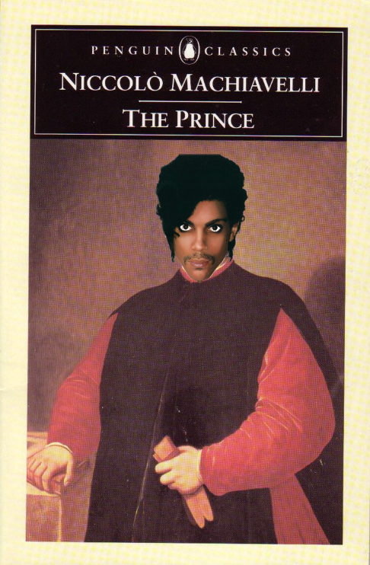
POLITICS
Machiavelli
Believes good is power.
Believes in the greatest good for the leader, not for the majority.
Who do we serve as communicators?
Notes:
Slide 19:
When we hear about the ends justifying the means we usually think about Machiavelli and The Prince. The Prince is a controversial book and it helps to understand what was going on between Italian city states, and Spain and France at that time. Machiaveilli was a civil servant who had been forced out of the game for awhile, and this book was like a long cover letter to Lorenzo de Medici about how to rule a principality. In short, Machiavelli proposes that the political end goals of glory and survival can justify the use of immoral means. That is the big difference between Utilitarianism and Machiavelli; In The Prince, the primary goal is holding onto power. Holding onto power supercedes virtue, principle, and any consequence that benefits the majority…unless it benefits the majority in a way that gets them to fear or love you more. Since all of us work in Public Administration it benefits us to consider political realities. To anticipate what an elected official might do to gain popularity, power, or votes. For the rest of the presentation, simply for the sake of thinking about an ethical alternative, I’ll occasionally refer to the “machiavellian” option but I am not implying that all politicians are machiavellian. Sometimes elected officials have different values than public administrators, and it is worth being cognizant of those values when determining the right thing to do.
The Prince

Slide 20
QUICK RECAP
Virtue
Principle
Consequence
Politics
Notes:
Slide 20
Before we go into applying these methods let’s do a quick recap.

Slide 21
Springfield and clarksville
A leader wants to build a road between Springfield and Clarksville, but this would mean destroying homes and businesses along the way.
What would the person of virtue consider?
What would the person of principle consider?
What would the person of consequence consider?
What would the Machiavellian consider?
Notes:
Slide 21 (2 minutes)
Let’s say a leader wants to build a road from Springfield to Clarksville. The problem is that the leader needs to destroy homes in order to build this road. If we are focusing on virtue, what would the leader consider? Go through each one.

Slide 22
Springfield and clarksville
Virtue: justice, generosity, courage, honesty.
Principle: Legal ability and precedence.
Consequence: Transportation for many versus land ownership of a few.
Machiavelli: Will this get me more power, obedience, votes?
Notes:
Slide 21 & 22
Virtue: Generosity – what can we give both sides so everyone is happy? Courage – talk to each home owner in person to explain project? Justice – fair trade-off for all involved.
Principle: If eminent domain is ok in this situation, it is ok in all situations. If we relocate someone when we build a road, we have to do that every time.
Consequence – Destroying 100 homes but providing a road for thousands for people to drive on. Good for majority of people.
Machiavelli – Will this get me loved, feared, reelected?

Slide 23
ethical dilemmas and the ethical triangle
Right
Versus
right

Slide 24
The ethical triangle
Framing the question based on virtue, principle, and consequence.
Virtue
Define the problem
  right vs. right
Consider responses
Test response against the ethical triangle
Consider other responses
Choose response
Implement response
Principle
Consequence
Notes:
Slide 24
As I said earlier, ethical dilemmas involve competing values and value systems. Honesty versus loyalty. Following organizational rules versus the US constitution. Justice versus mercy. Short term gain versus long term gain. When we use the ethical triangle, we use all of those value systems. We define the problem, test the problem against virtue, principle, and consequence, considering other responses, finalizing our response, and then implement it.

Slide 25
First DILEMMA: public speaking
You are participating in a presentation on ethics at a conference.
You have questions but don’t want to be embarrassed.
Notes:
Slide 21 (2 minutes)
Let’s say you are participating in a presentation on ethics at a conference. You have questions about the topic but you don’t want to be embarrassed by either asking a question you think isn’t intelligent, or by accidentally saying the wrong words or saying them wrong, or by implying that you have ethics issues in your organization. Lets go through the ethical triangle process.

Slide 26
Possible responses
Define the problem
Consider responses
Consider audience and other participants
Notes:
How would we define this problem?
Wanting to learn versus maintaining integrity. Maybe this is where expertise is a value. Or maybe it is friendliness – you want to understand my point of view but don’t want to appear like you’re the only one who didn’t get it.
Integrity versus friendliness? Maybe you disagree with a point someone has made but you don’t want to come across as aggressive against someone?
What are our responses?
Ask the question.
Don’t ask the question.
Consider the audience:
Colleagues. Me. Is anyone sitting next to their boss?
So lets test out a response. Let’s say you didn’t understand what I meant when I said that The Giving Tree is a depressing book. So you want me to explain why I believe the Giving Tree is depressing because you want to understand my point of view but you are afraid that everyone else agrees with me and you don’t want to be embarrassed. The issue here is wanting to understand me, which could be wanting to be friendly or wanting to learn more, versus protecting your integrity. You don’t want to appear like you didn’t understand what I was talking about. You have decided that your response will be to not ask for more information on an opinion you do not understand. You’ve also considered your audience which is your fellow colleagues and maybe a boss or a direct report.

Slide 27
Test response against triangle
Virtues: Advocacy, Honesty, Expertise, Independence, Loyalty, Fairness. Friendliness? Courage?
Principle: Could you do this all the time?
Consequence: Best results for the majority?
  Impact on minority?
Notes:
You have decided that your response will be to not ask for more information on an opinion you do not understand.
Let’s test this against virtue: Are you advocating for yourself or for others if you do not ask the question? Are you being honest if you do not share your thought that you didn’t understand my point. This is of course different than saying that you did understand what I said when you actually didn’t. I could say you aren’t learning, you aren’t increasing your expertise, if you don’t get an answer to your question. Or maybe you aren’t helping me to improve my expertise? Maybe I was totally wrong about The Giving Tree, and then you ask me to explain myself and I realize I was wrong. I’m not sure if the other virtues on there have anything to do with the issue. I added one of Aristotle’s virtues up there, friendliness, because maybe the idea of disagreeing with someone feels unfriendly to you. There’s also courage. Is it more courageous for you to not ask the question or to ask it?
Principle: First off, we know it is not illegal in this country or in this organization to ask questions during a presentation at a CAPIO conference. I would ask two questions: If you don’t understand what a speaker is saying during a presentation, is it always the best choice to not ask a question during the presentation? And then lets apply the golden rule: If you were giving a presentation, and you asked the audience to respond, how would you feel if they didn’t respond?
And finally we have consequence: What impact will asking your question have on the majority? Will it help other people in the room understand the issue? You might also ask if the question is off topic and might bore everyone in here.

Slide 28
Choose and implement
Other responses
Choose response
Implement response
Notes:
Now we have asked a bunch of questions related to virtue, principle, and consequence. What other responses could you implement other than not asking the question at all?
Ask me later.
Email me.
Ask someone else to ask it.
Give me a fake name and then ask it.

Slide 29
Ethical dilemmas
Protecting Informants vs. Honesty with the Public
  On February 12, 2016, the Santa Maria Police Department distributed a press release stating that two cousins had been arrested for identity theft and turned over to ICE. In actuality, the two men had not been arrested and a fake press release was used by the police to protect the cousins from a local gang. The press release was also used to protect the integrity of a long-term investigation and prevent the gang from learning that their communications were being tapped.
Notes:
Slide 25
I submitted the idea for this presentation after reading the following story which happened an hour north of Santa Barbara in Santa Maria. On February 12, 2016, the Santa Maria Police Department distributed a press release stating that two cousins had been arrested for identity theft and turned over to ICE. In actuality, the two men had not been arrested and a fake press release was used by the police to protect the cousins from a local gang that was targeting them. The press release was also used to protect the integrity of a long-term investigation and prevent the gang from learning that their communications were being tapped.
https://www.washingtonpost.com/news/morning-mix/wp/2016/12/05/your-government-lying-calif-police-issue-fake-press-release-used-the-news-media-as-part-of-investigation/
Ask what people think – was this ok?

Slide 30
Possible responses
Define the problem
  Protecting informants vs. being honest with the public
Consider responses
  Santa Maria Police response – distribute fake press release in order to prevent gang from believing informants were in police custody.
Consider audience and other participants

Slide 31
Test response against triangle
Distribute fake press release
  Virtues: Advocacy, Honesty, Expertise, Independence, Loyalty, Fairness. Justice?
  Principle: Could you do this all the time?
  Consequence: Best results for the majority?
    Impact on minority?
Notes:
Virtues: honesty versus justice
Principle: Would it be good to lie all the time to protect the public? Is it ok to lie to a suspect during an interview?
Consequence: Is this the best result for the majority? Maybe it is. Depending on your demographics maybe your residents won’t care if you lie to arrest a gang. Protecting public and informants?

Slide 32
Consider other responses
Other responses
Choose response
Implement
Notes:
What are some alternative responses you would implement?

Slide 33
CONCLUSION
“(Police Chief Martin) has yet to remove the bogus press release from Nixle, even though it violates the service's terms, which forbid knowingly publishing "fraudulent, deceptive, or misleading communications." [S]anta Maria Police Chief Ralph Martin wasn’t aware what the terms of service were or that they existed when initially asked by the Sun. At first, Martin said he’d more than likely take the press release down, but then he changed his mind. “I don’t have any plans to take it down,” Martin said, adding that he has yet to be notified by Nixle. “If it violates their policy then it’s Nixle’s policy to contact us.”
Notes:
I’ve found it difficult to keep up with what’s going on as I’ve been creating this presentation. On March 23, so a little over a week ago, a story came out regarding the press release and how it violates Nixle’s terms of service.
https://www.techdirt.com/articles/20170319/10040836951/california-police-department-cant-keep-it-real-deploys-fake-press-releases-fake-affidavits.shtml

Slide 34
ETHICAL DILEMMAS
Triangle shows an ethical decision could be made to protect the investigation and the informants rather than be honest with the public.
However, THIS VIOLATES SO MANY PRSA principles:
  Truth
  Accuracy
  Integrity
  Reputation
Notes:
I picked this example because on one hand you can look at the triangle and see where someone could ask the same questions we asked and come to an ethical decision that it is more important to protect the investigation and the informants than it is to be honest with the public. The police chief unapologetically focused on justice and the consequence of protecting the public and minimized honesty and potentially setting a bad precedent of lying to the public. This example violates the PRSA value of honesty and it also hurts the department’s integrity and reputation.

Slide 35
Ethical dilemmas
Elected Official Event
You are the PIO for a Parks Department.
Elected official asks you to sponsor event for Homeless Veterans.
Requires operating a booth and donating $1000 to the event.
Board supports the event.
Supporting the event might get you support for more staff. A high ranking staff member confirms this.
Your department does not have funds set aside for events.
Event also does not align with your mission.
Notes:
Slide 31
A little over a month ago I emailed people who had signed up for this presentation and asked them what dilemmas they were interested in discussing. Using that input I pieced together a fictional scenario for us to work through.
You are the PIO for a Parks Department and an elected official in your organization asks you to sponsor their Homeless Veteran’s Support event. This event provides services to homeless veterans in the area. Support requires manning a booth and donating $1000 to the event.
The event is a benefit to the community and the entire elected board supports the event.
It is possible that by supporting the event you might get support for more staff from the elected official during budget deliberations. A high ranking staff member outside of your department confirms this.
However, your department does not have funds set aside to pay for the booth or pay for staff to operate the booth.
The event also does not align with your mission because Parks does not provide services to the homeless, your parks are not in an urban area, and you do not have a homeless problem at your parks.

Slide 36
Possible responses
Define the problem
Consider responses
Consider audience and other participants
Notes:
Slide 32:
First lets define the problem. What are the two good yet competing choices here?
Increased resources for your department vs following the law.
Consider responses:
Use funds dedicated to another program for the event
Recruit a non-profit to help
Pay the $500 yourself and work for free
Audiences:

Slide 37
Test response against triangle
Decision
  Virtues: Advocacy, Honesty, Expertise, Independence, Loyalty, Fairness. (Justice? Generosity?)
  Principle: Could you do this all the time?
  Consequence: Best results for the majority? Impact on minority?
Notes:
Slide 33:

Slide 38
Consider other responses
Other responses

Slide 39
Choose and implement
Choose response
Implement response
Notes:
What response would you implement?

Slide 40
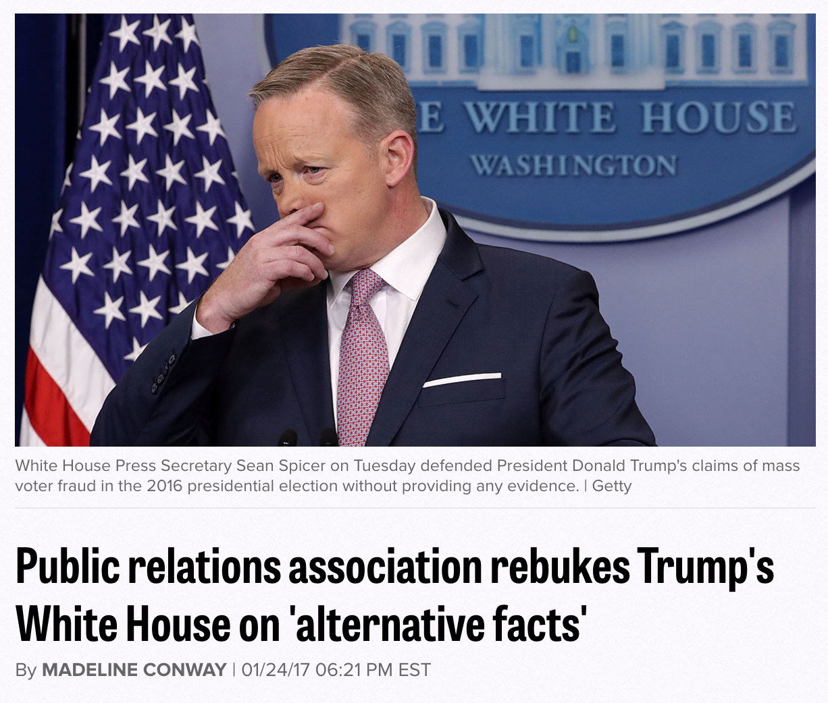
CONCLUSION
Notes:
As I said earlier, I proposed this talk on ethics to CAPIO after hearing about the fake press release story in Santa Maria. The press release was fake and I disagree with the tactic, but I can understand that they value protecting lives and an investigation over being consistently honest with the public. What I didn’t know, was that within a couple months we would be living in a world where professional communicators would encourage using “alternative facts” to promoting a lie to protect the President’s pride. After Press Secretary Sean Spicer continued to support the fake crowd size message at a press conference, PRSA released a statement rebuking Spicer. The PRSA Chair Jane Dvorak wrote that “PRSA strongly objects to any effort to deliberately misrepresent information. Honest, ethical professionals never spin, mislead or alter facts. We applaud our colleagues and professional journalists who work hard to find and report the truth.”
I think that statement sums up why ethics is important in public relations. Our job is to promote social harmony, and we can only do that if first and foremost we are honest with the public. That’s how we foster relationships built on trust. We make decisions to do the right thing because we believe in our profession – and this is why it is important to address other communicators when they blatantly disregard facts. We practice ethical behavior because we want to protect the reputation of the organizations we work for.

Slide 41
Thank you
References:
Notes:
As I said earlier, I proposed this talk on ethics to CAPIO after hearing about the fake press release story in Santa Maria. The press release was fake and I disagree with the tactic, but I can understand that they value protecting lives and an investigation over being consistently honest with the public. What I didn’t know, was that within a couple months we would be living in a world where professional communicators would encourage using “alternative facts” to promoting a lie to protect the President’s pride. After Press Secretary Sean Spicer continued to support the fake crowd size message at a press conference, PRSA released a statement rebuking Spicer. The PRSA Chair Jane Dvorak wrote that “PRSA strongly objects to any effort to deliberately misrepresent information. Honest, ethical professionals never spin, mislead or alter facts. We applaud our colleagues and professional journalists who work hard to find and report the truth.”
I think that statement sums up why ethics is important in public relations. Our job is to promote social harmony, and we can only do that if first and foremost we are honest with the public. That’s how we foster relationships built on trust. We make decisions to do the right thing because we believe in our profession – and this is why it is important to address other communicators when they blatantly disregard facts. We practice ethical behavior because we want to protect the reputation of the organizations we work for.

